Slide 1


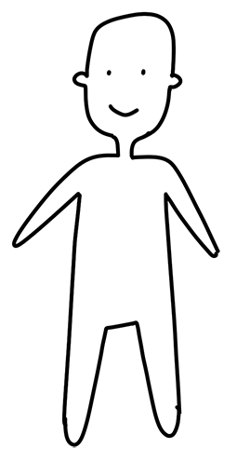
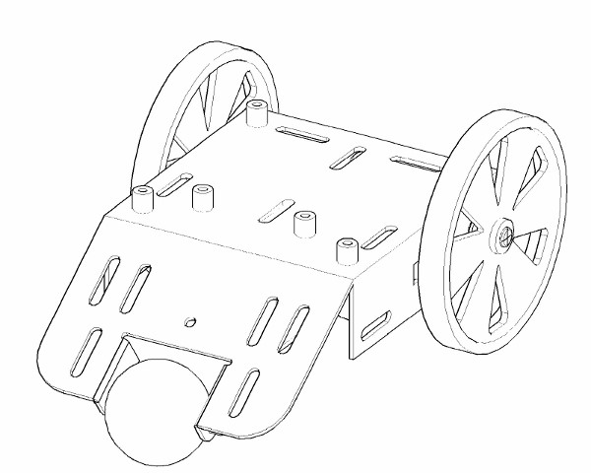
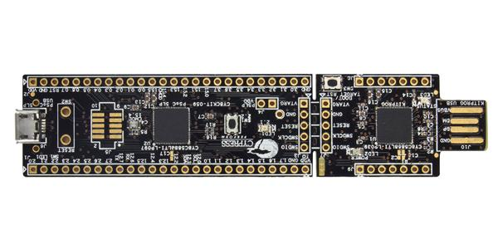



Semesterprojekt 4 - iFollow
Web – Server (Wi-Fi)
Interface
Wi-Fi
RPi
User
Kommunicating With
Follow
Microcontroller
Controlled by
playing
controlling
Using
Robot
Sound
Motor
Sensor

